Slide 1
Dobot Robot Products Catalog

Slide 2
Type |  | Dobot Magician
Controlled Axes |  | 4
Payload |  | 0. 5kg
Max. Reach |  | 320mm
Position Repeatability(Control) |  | 0. 2mm
Range of Motion | J1 | ±90°
 | J2 | 0°〜85°
 | J3 | -10°〜95°
 | J4 | ±90°
Maximum Speed | J1 | 160°/s
 | J2 | 160°/s
 | J3 | 160°/s
 | J4 | 300°/s
Power Supply |  | 100-240VAC. 50-60Hz
Control platform |  | ARM Cortex-M3 + FPGA
Operating System |  | /
interface |  | USB etc.
I/O |  | 1. I/O × 10 (Configurable as Analog Input or PWM Output) 2. Controllable 12V Power output × 4 3. Communication Interface (UART, Reset, Stop, 12V, 5V and two I/O included) 4. Stepper × 2
Software |  | DobotStudio
DOBOT-Magician
Features ：
Multi-function
Abundant interface
Rapid deployment
Highly cost-effective
Typical Application Scenario ：
Guangzhou City Transportation card Testing
Chow Tai Fook jewelry weighing、 sorting
Mobile screen assembly Testing
BOSE Hi-fi equipment button testing
Intelligent commode button testing

Slide 3
DOBOT-Sliding Rail Kit
Type | Sliding Rail Kit
Effective Distance | 1000m
Payload | 5kg
Max. Speed | 150mm/s
Maximum Acceleration | 150mm/S2
Repeat positioning accuracy | 0.01mm
Absolute positioning accuracy | 0.25mm
Net Weight | 4.7KG
Weight (including packing) | 7.23KG
Dimension(Lenth × Width × Height) | 1320mm × 120mm × 55mm
Make your robot go further
1 more meter working range brings you endless possibilities!With the sliding rail kit, the working space of Dobot Magician can be fully extended. It can do large-scale tasks, such as long-distance picking and placing, a large range of writing, drawing or laser engraving.

Slide 4
DOBOT-Conveyor Belt
Type | Conveyor Belt
Effective Distance | 600m
Payload | 500g
Max. Speed | 120mm/s
Maximum Acceleration | 1150mm/S2
Measurable range | 20 ~ 150 mm
Distance measuring sensor unit Signal | Analog Output
Distance measuring sensor unit Input | 4.5--5.5V
Color recognizing sensor unit input | 20 ~ 150 mm
Color recognizing sensor unit input | Detectable : non-glowing object White LED embedded, on/o controllable
Net Weight | 4.2 KG
Weight (including packing) | 5.34 KG
Dimension(Lenth × Width × Height) | 700mm × 215mm × 60mm
Simplest mini production line
The Conveyor Kit for Dobot Magician makes you have a complete production line simulation. Conveyor belt with adjustable speed, distance and color sensor,combined with the powerfuland programmable Dobot Magician, these are the ideal essentials for you to create a highly effective simulated production line, or even to apply to actual factory scenes

Slide 5
Dobot Magician - Robot Vision Kit
HD Color Industrial Camera | Product Number: JHSM300f Sensor Size: 1/2’CMOS Sensor Type:MT9T001 Effective Pixel: 3 million Hue colour Pixel Size: 3.2x3.2um Frame Rate / Resolution :12 @2048×1536 Filter :650nm SNR :42dB Dynamic range: 61dB shutter type Curtain exposure Time of exposure: 50.8um– 3329ms Exposure control auto/manual Size :40x45x45mm data interface: USB2.0
White auxiliary light source | Product number: JHZM-A40-W Luminous color white LED number 48 LED illumination 40000lux brightness Continuously adjustable, adjustable range ~100% Color temperature constant wavelength: 455– 457.5nm output voltage: 12 V output power :3.5 – 5 W Operating distance :35 – 110mm Size specification internal diameter：40mm, external diameter：70mm,height：25mm Outer diameterof lamp barrel MaxΦ39mm Weight 0.48KG Working environment temperature：0 ~ 40℃，humidity：20~85%RH Storage environment temperature：-20 ~ 40℃，humidity：20 ~85%RH
The Robot Vision Kit provides a basic set of hardware platform for robot vision system development. You can set up the vision kit with Dobot Magician and start to learn how to integrate vision system with robot automation system. With the system, you can also do some researches on vision, artificial intelligence algorithm-simulation, or develop vision based industrial applications.
Except for the examples of basic robot vision application software, we also provide the source code for you to learn robot-related software development. The demo project includes two parts: robot calibration and color based sorting.

Slide 6
Type |  | Dobot M1
Controlled Axes |  | 4
Payload |  | 1. 5kg
Max. Reach |  | 400mm
Position Repeatability(Control) |  | 0. 02mm
Cycle time |  | 0.45s
Range of Motion | J1 | ±90°
 | J2 | ±135°
 | Z | 250mm
 | R | ±360°
Maximum Speed | J1 | 160°/s
 | J2 | 160°/s
 | J1+J2 | 2000mm/s
 | z | 1000mm/s
Power Supply |  | 100-240VAC. 50-60Hz
Control platform |  | ARM Cortex-A9 +ARM Cortex-M4+ FPGA
Operating System |  | Linux
Interface |  | Ethernet,RS-232C,USB HID
I/O |  | 24V input×8, 24V output×8
Software |  | DobotStudio
DOBOT-M1
Features：
Plug-and-play
Intelligent interface
Widely used
Integrated design
Concise dexterous
Typical Application Scenario：
Sorting operations with visual system
PCB plug-in, welding operation
Flaw detection
Packing operation
Loading and unloading of small automatic equipment

Slide 7
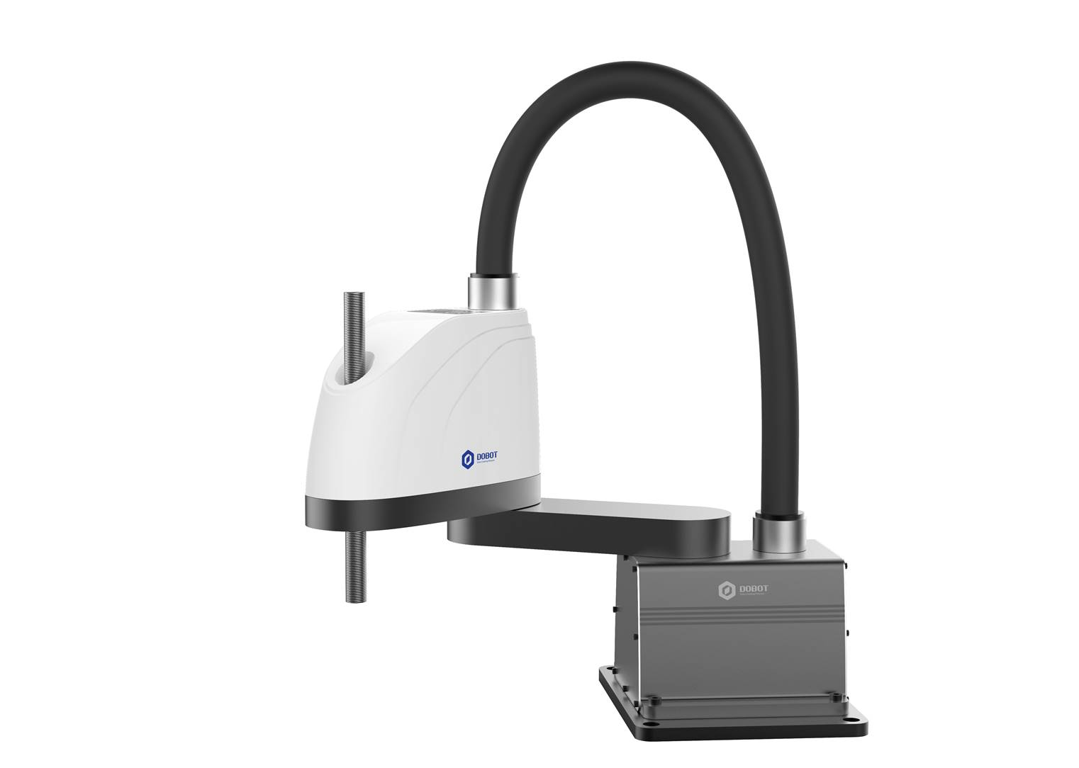
Type |  | Dobot SR4-5
Controlled Axes |  | 4
Payload |  | 5kg
Max. Reach |  | 500mm
Position Repeatability (Control) | J1 | ±0. 01mm
 | J2 | ±0. 01mm
 | Z | ±0. 01mm
 |  | ±0. 1mm
Range of Motion | R | 500mm
 | Z | 200mm
 | TH1 | ±120°
 | TH2 | ±145°
 |  | ±360°
Maximum Speed |  | 6000mm/s
 | Z | 1000mm/s
 | TH1 | 225°/s
 | TH2 | 360°/s
 |  | 1000°/s
Net weight |  | 40kg
Power Supply |  | 100-240VAC. 50-60Hz
Control platform |  | Open PC architecture
Operating System |  | Linux
Interface |  | Ethernet,RS-232C
I/O |  | input×16, output×16
Dobot-SR4-5
Features：
Agile and fast
Highly cost-effective
Reliable
Easy installation
Easy operation
Maintenance friendly
Typical Application Scenario：
Sorting operations with visual system
PCB plug-in, welding operation
Flaw detection
Packing operation
Loading and unloading of small automatic equipment

Slide 8
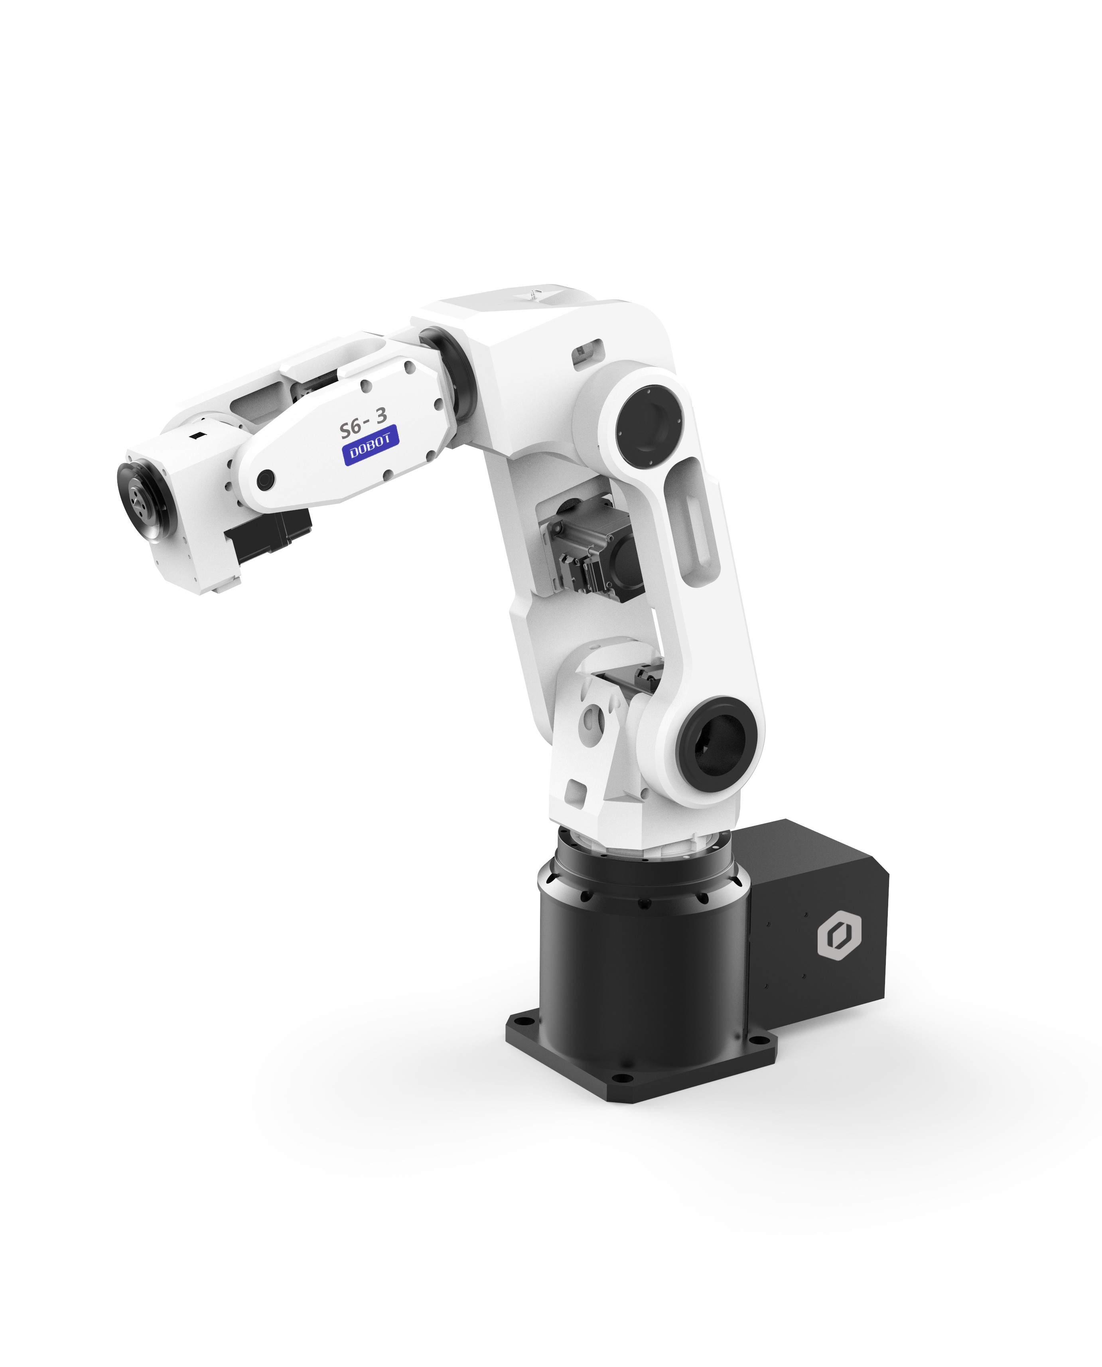
Type |  |  | Dobot-SR6-3
Controlled Axes |  |  | 6
Payload |  |  | 3kg
Max. Reach |  |  | 700mm
Position Repeatability(Control) |  |  | ±0. 03mm
Range of Motion | J1 |  | -170°~ +170°
 | J2 |  | -60°~ +135°
 | J3 |  | -40°~ +170°
 | J4 |  | -180°~ +180°
 | J5 |  | -100°~ +100°
 | J6 |  | -360°~ +360°
Maximum Speed | J1 |  | 250.5°/s
 | J2 |  | 250.5°/s
 | J3 |  | 250.5°/s
 | J4 |  | 185.55°/s
 | J5 |  | 247.41°/s
 | J6 |  | 601.2°/s
Net weight |  |  | 49kg
Power Supply |  |  | Three-phase 220v
Control platform |  |  | Open PC architecture
Operating System |  |  | Linux
Interface |  |  | Ethernet,RS-232C
I/O |  | input
 |  | output
Pneumatic piping |  |  | Φ6 hose
Dobot-SR6-3
Features：
Multi machine control technology
Fast and accurate
Concise dexterous
Agile and fast
Typical Application Scenario：
Dispensing operation
Products 3D detection
Small assembly line feeding and unloading
Assembly operation

Slide 9
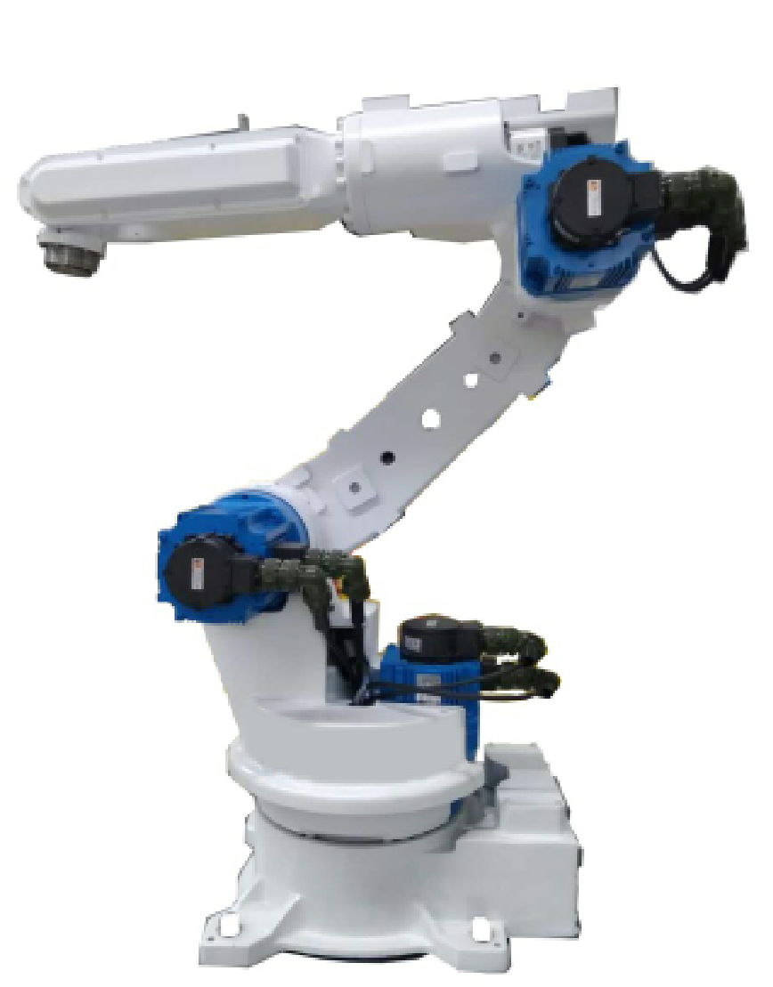
Type |  |  | Dobot-SR6-12
Controlled Axes |  |  | 6
Payload |  |  | 12kg
Max. Reach |  |  | 1406mm
Position Repeatability(Control) |  |  | ±0. 06mm
Range of Motion | J1 |  | -170°~ +170°
 | J2 |  | -90°~ +155°
 | J3 |  | -20°~ +170°
 | J4 |  | -180°~ +180°
 | J5 |  | -50°~ +230°
 | J6 |  | -360°~ +360°
Maximum Speed | J1 |  | 230°/s
 | J2 |  | 225°/s
 | J3 |  | 230°/s
 | J4 |  | 480°/s
 | J5 |  | 480°/s
 | J6 |  | 750°/s
Net weight |  |  | 163kg
Power Supply |  |  | Three-phase 220v
Control platform |  |  | Open PC architecture
Operating System |  |  | Linux
Interface |  |  | Ethernet,RS-232C
I/O |  | input
 |  | output
Pneumatic piping |  |  | Φ6 hose
Dobot-SR6-12
Features：
Excellent dynamic load performance
Original assembly of motor and reducer
High precision drive integrated technology
Smooth and compliance
Advanced modular design
Typical Application Scenario：
Machining center feeding and unloading
Cargo handling
Welding operation

Slide 10
Type |  | Dobot Mooz
Parameters | Overall Dimensions | 285 * 285 * 318mm
 | Adapter Input | 100-240V~50/60Hz, 1.8Amax
 | Adapter Output | -12V~6.5A
 | Main Material | aircraft-grade aluminum
3D Printing | Nozzle Diameter | 0.4 mm
 | Layer Resolution | 0.05~0.3 mm
 | Nozzle Temperature | 190~260℃
 | Heated bed Temperature | 50~100℃
 | Forming Size | X130 * Y130 * Z130mm
 | Printing Speed | 10~80mm/s
 | Applicable Materials | PLA, ABS , PC , FLEX
Laser Engraving | Working Range | X130 * Y130mm
 | Supported Materials | wood, paper products, some plastics, leather, etc.
 | Laser Power | 0.5/1.6W (optional)
CNC Carving | Spindle idle Speed | 12000rpm Max
 | Clamping Range of CNC Chuck | 0~4mm
 | Size of Standard CNC Bit | 3.175mm * 0.3mm * 30° flat bottom sharp cutter
 | Supported Materials | wood, plastics, PCB boards and most non-metallic materials
DOBOT-Mooz
Industrial Grade Transformable Metallic 3D Printer CNC+ LASER

